Slide 1
Attendance vs. Temperature
Is there a correlation between temperature and attendance per game?

Slide 2
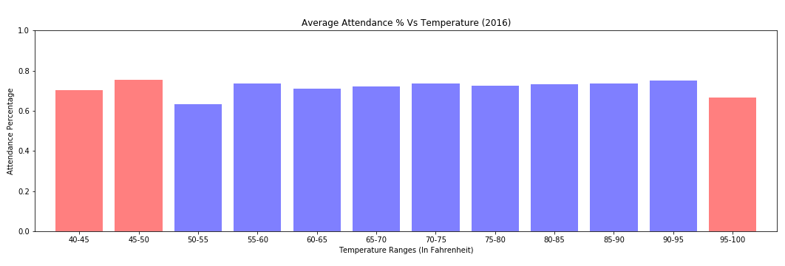

<30 data points
>30 data points
Why we used Attendance Percentage instead of Attendance
Binned the data every 5 degrees Fahrenheit
Removed games played in domes

Slide 3
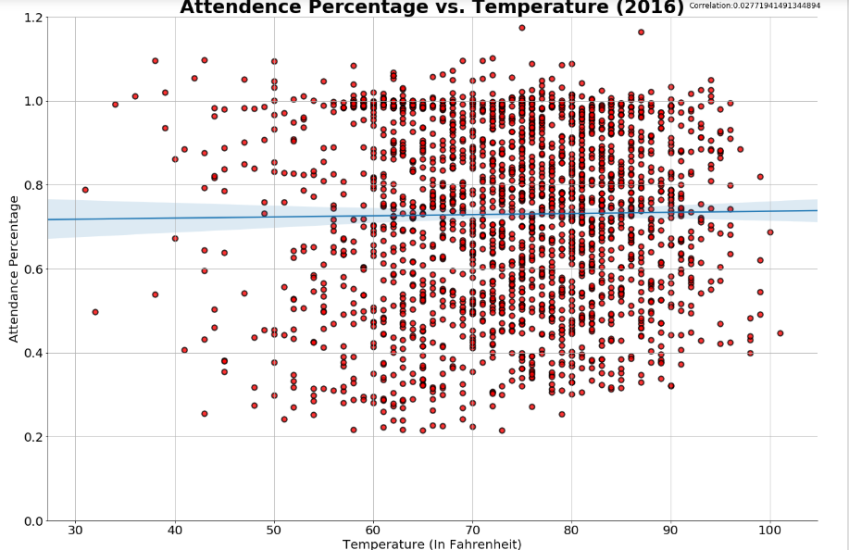

Slide 4
Conclusions
The attendance data that we used did not contain the actual attendance at the game.
With a correlation of 0.0277, we conclude that there is no correlation between temperature and attendance (ticket sales).
Reasoning: Tickets are usually purchased weeks or months in advance.

